Slide 1


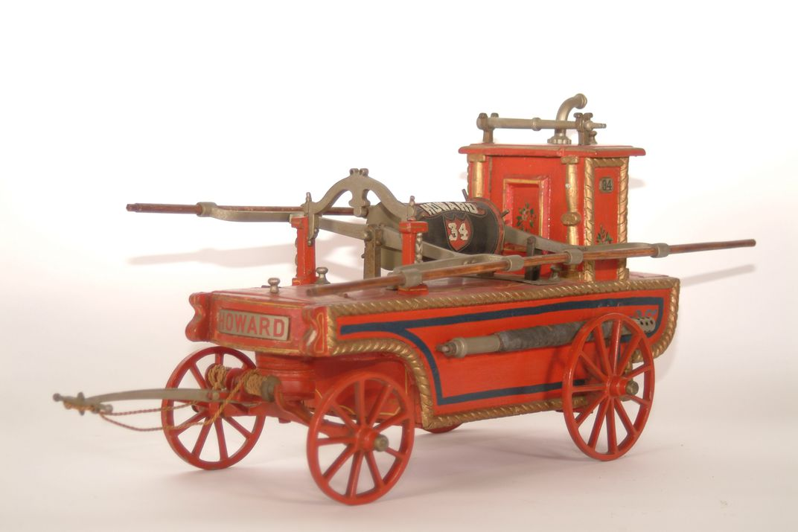
Fire Service Coordinator FESC AGM update
April 07, 2022

Slide 2
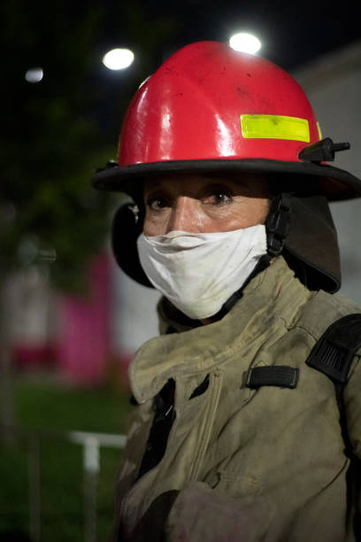
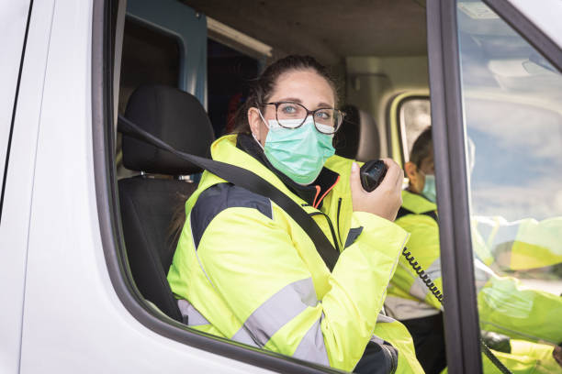
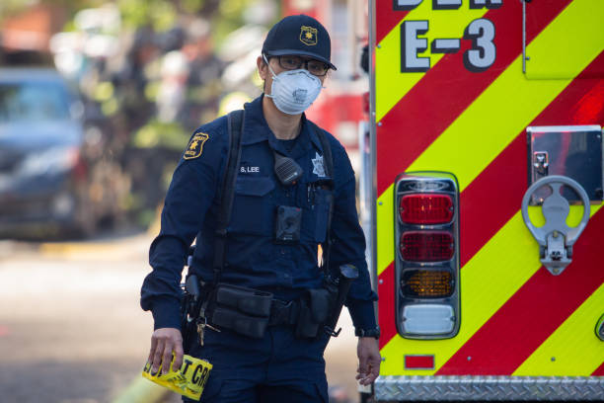
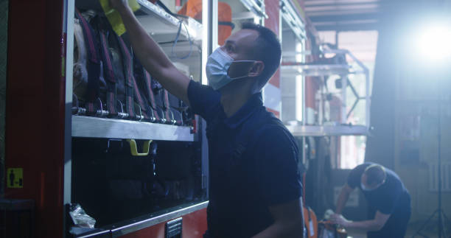
Covid-19 2021

Slide 3
Fire Service Coordinator Role
Work with Fire Departments in MDOL

Slide 4
Service Awards
Fire Service Awards 2021
Firefighter Years of Service
3 -50 yr. 4- 45 yr. 1-35 yr. 5- 20yr. 3-20yr.
Station years of service were given also
2-75 yr.(NGFD, RDFD), 1-55 yr.(DDFD).
1-50yr.(HFD) 1-45yr.(UCFD) 1-30yr.(WFD)

Slide 5

=
Firefighter Services Awards

Slide 6


From FESC Workshop on Priorities
“Appendix “A”
Topic |  | RANK
Maintenance & Testing Standards |  | 1
Training (R&R) Standard/Best Practices |  | 2
Mental Health ( R&R, EFAP) |  | 3
Bulk Purchasing |  | 4
Coordination with REMO |  | 5
Financial Capacity |  | 6
Governance |  | 7
Assessment Coding |  | 8

Slide 7
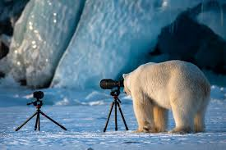
Mutual Aid Agreement
Scene security
Leadership training

Slide 8
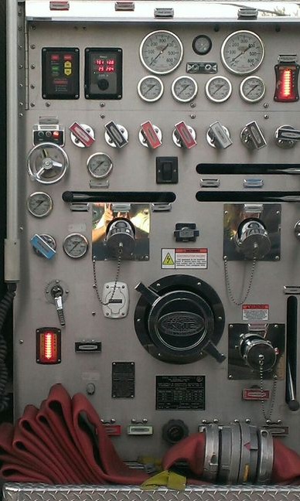
Requirement for Mandatory Pump Testing Standard

Slide 9
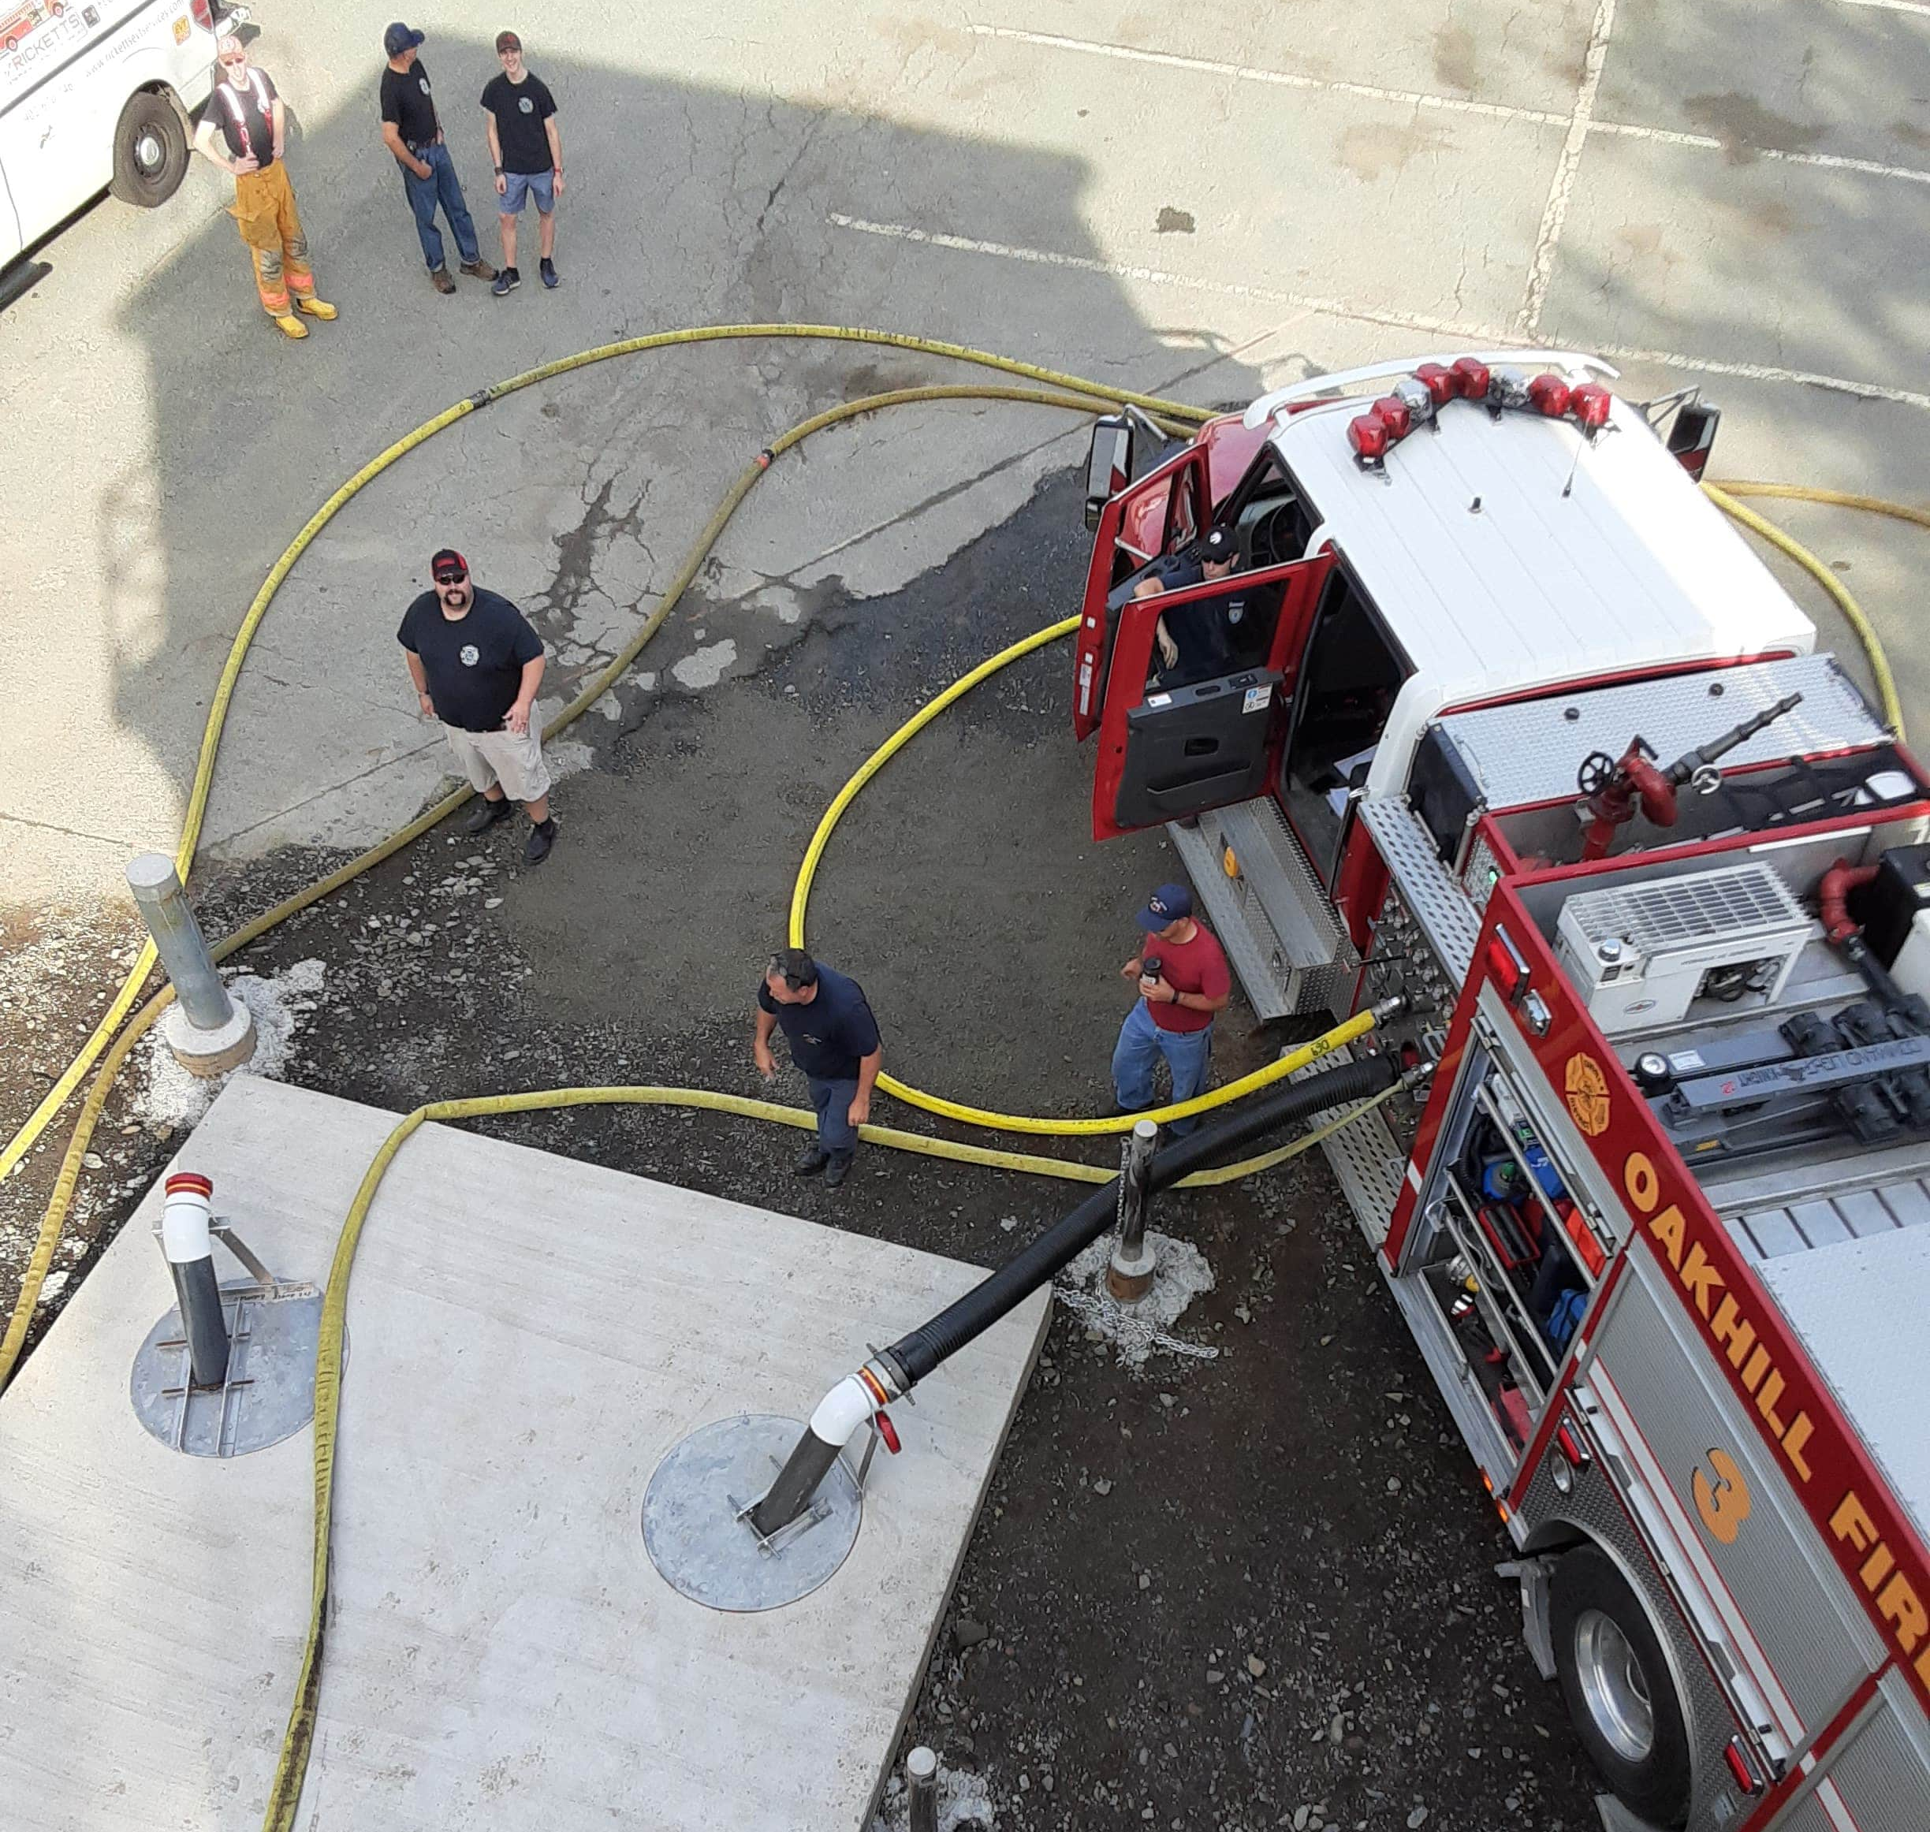
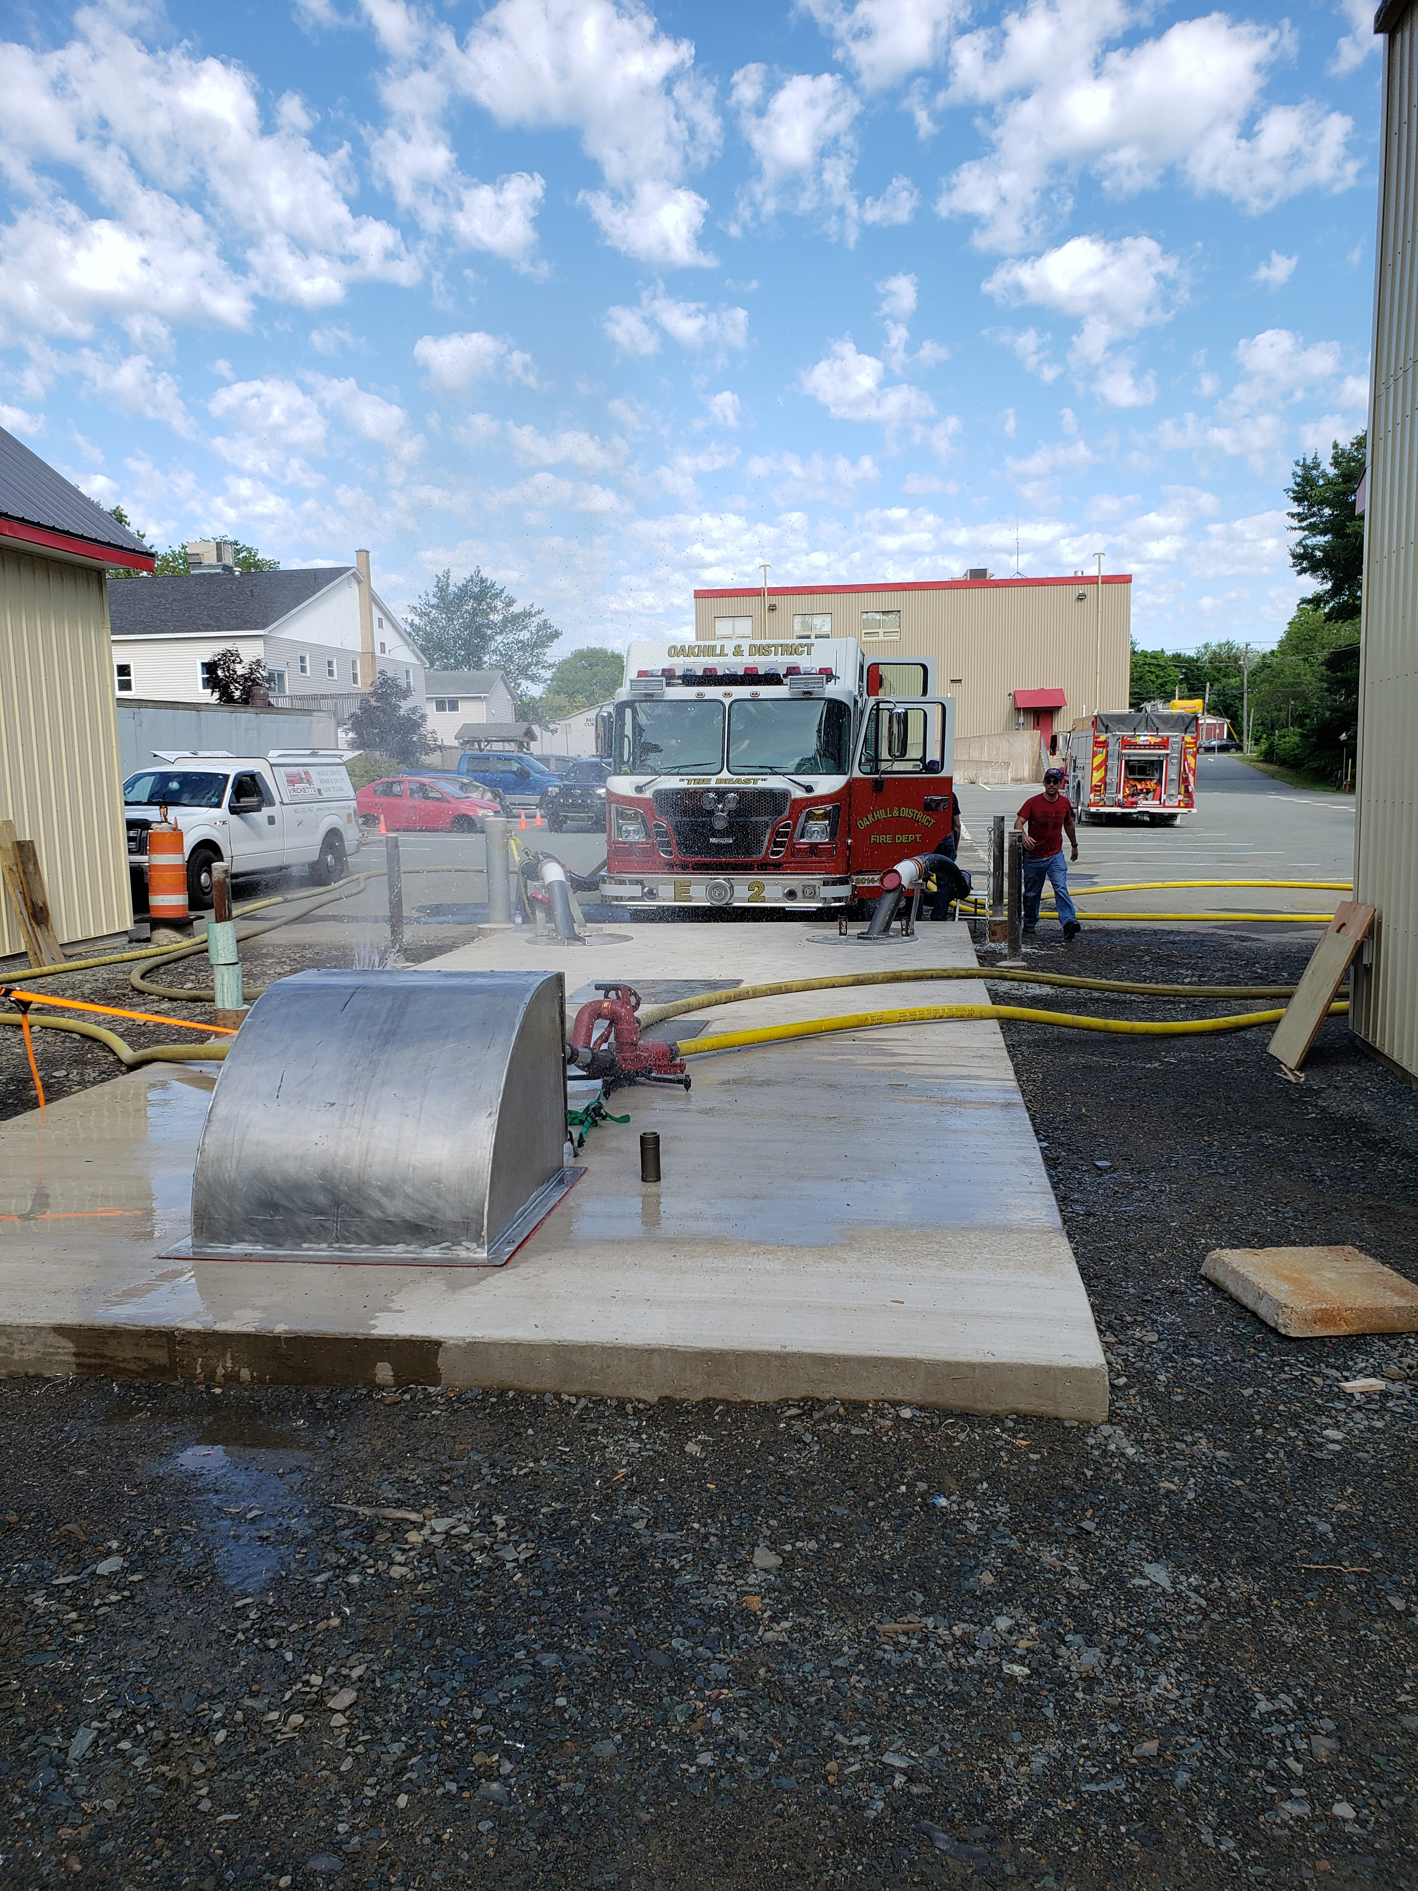
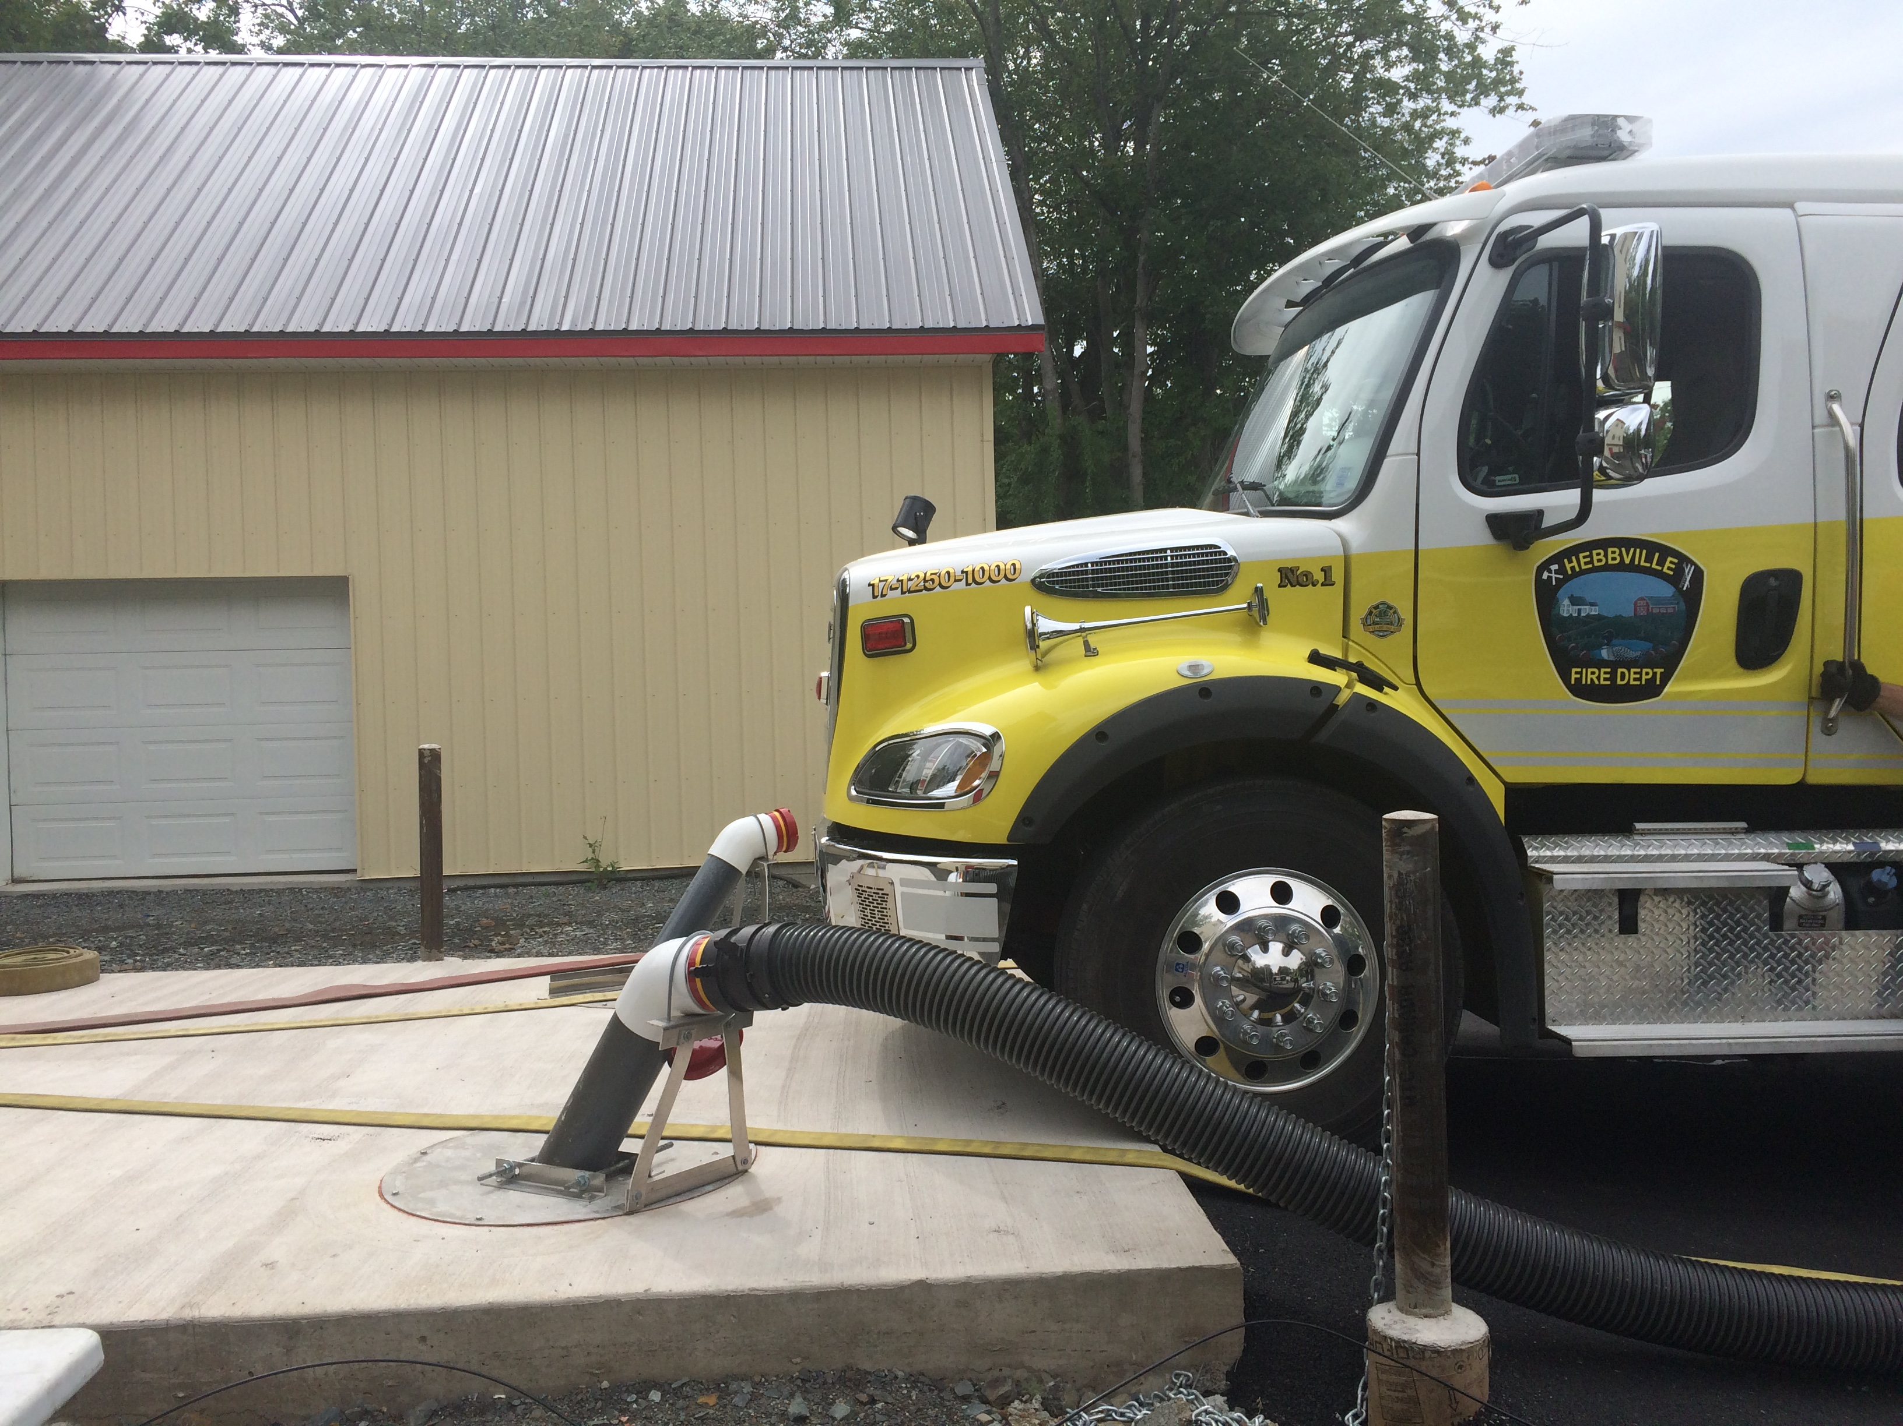
New Joint Pump Testing Facility
Hopefully more departments will utilize it in 2021

Slide 10
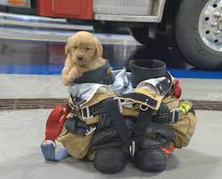

Slide 11
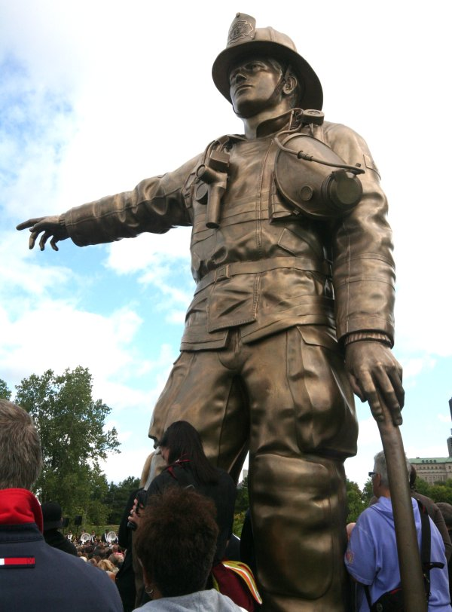
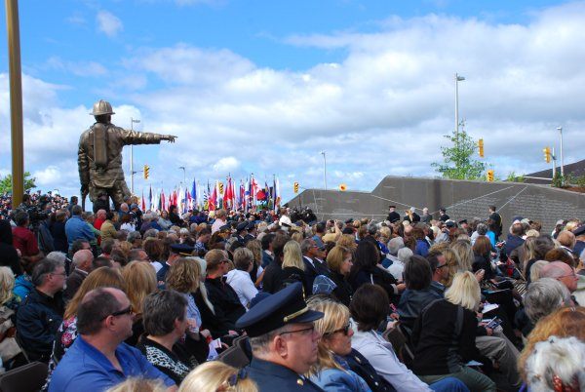
Firefighter Safety Initiative Everyone Goes Home

Slide 12
Registration Information Update from 2020
Registered Medical First Responders – 214 2019 was 198
Structural Firefighters- 333 2019 was 349
Active Firefighters- 597 +8 2019 was 589
Junior Firefighters- 35 +1 2019 was 34
Auxiliary members- 191 2019 was 191
Honorary and Other members- 182 2019 was 174
Firefighter insurance costs last year Around the $60,000.00 New personnel insurance $38,542.00 ($10,900 Grant)
Self-contained Breathing Apparatus(SCBA) Functional Testing All but 1
Pump Testing- some issues 2019 not done 3
Fire Department Fund Raising -$373,329.00 -54% ( FF 50/50 Helped some) 2019 was $691,052.00

Slide 13
Calls By types 2020

Slide 14
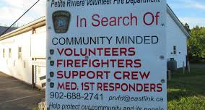

Cost to Outfit One Firefighter
Helmet $300-$500
Hood- $170
Mask- $400 and up
SCBA $13,500.00
Bunker Gear $2400
Radio $600 to $2500 TMR
Pager $600
Boots $200 to $800
Gloves $200
Avg Total $17,900.00
Recruitment & Retention
Recruitment and retention moving forward
MODL continued funding to help with Recruitment and Retention Advertising/Newsletters, Flyers
Have heard from some dept’s this has helped with recruitment
EFAP for firefighters
Fire Service Coordinator offering sessions to fire services on grounding centering exercises

Slide 15

Funding to fire services outside of FD Area Rates approved for 2022-2023 Fiscal Year
Recruitment and Retention $44,500.00
WCB Premiums est. $40,000.00
    Total Non-grants $ 74,500.00
Municipal Grants ;
Matching Grant $44,115.00
Municipal Grant $66,698.00
Training Grant $11,343.00
Insurance Grant $56,304.00
Group Personnel Insurance $11,343.00
$189,842.00
  Total MODL Funding $264,342.00

Slide 16
Recruitment & Retention Ideas
$44,500.00 approved by council for areas to aid in recruitment and retention
Marketing $10,000
EFAP $12,000 (Slated for September 2021 launch)
Leadership Training Grant 7,500 …
Recognition Grant $15,000
New Post Merger Grant

Slide 17
Nova Scotia Firefighter 50/50 Draw
Funds raised by departments from the NS firefighter 50/50 draws can be claimed as fundraising and applied in the calculation of the MODL Matching Grant.,
These funds have assisted many departments through the past year during Covid related restrictions who were unable to maintain traditional fund-raising activities.
Allowed some departments to apply these funds to purchase new equipment that may not have been otherwise possible

Slide 18
